Slide 1

BASE
ROVER
Antenna
Tallysman TW7972
Antenna
Tallysman TW7972
Antenna
Tallysman TW7972
How the navigation module can communicate to the MCU ?
A: via a RS232 GPRMC NMEA
Like this: $GPRMC,001225,A,2832.1834,N,08101.0536,W,12,25,251211,1.2,E,A*03
Radio
not included in xNAV650
GNSS+IMU
Multi band
RTK
Base station
Can’t be xNAV650
MCU
HITEX ShieldBuddy TC375 or on Arduino MEGA
How communicating ?
A: Using serial input on the xNAV and an independent radio receiver.
Radio
not included in xNAV650
RTK
Motor control
With encoders

Slide 2
Decoding results
Position | 28.536390°N 81.017560°W
Timestamp | Sun, 25 Dec 2011 00:12:25 UTC
Movement | Speed 12.0 kts, heading 25°
Close to | Christmas, United States
Local time | Sat, 24 Dec 2011 19:12:25 EST
Timezone | America/New_York (UTC -0500)
https://rl.se/gprmc
Dear Customer Support,
I'm looking for moving base and robot rover setup for agricultural application in remote places.
My rover is using Arduino MEGA.
Base side MCU: still to be developed.
For Base – single rover configuration I'm searching for:
Base:
multi band GNSS receiver
+ XBee (up to 10km LoS) send the RTK correction data to the rover
+ 1 antenna
(The fix location of the base to be set after (10 min - 60 min) survey.)
Rover:
multi band GNSS receiver
+XBee (up to 10km LoS) to receive the RTK data from base
+ 1 or 2 antennas
+ IMU (for heading)
Please advise for system configuration.
I would highly appreciate, if You send a block diagram about the information flow as well :-).
In case of any questions, get it touch.
Thank You very much for Your help and support in advance.
Have a nice day ahead.
With Regards,
Andras
https://www.ardusimple.com/contact/

Slide 3
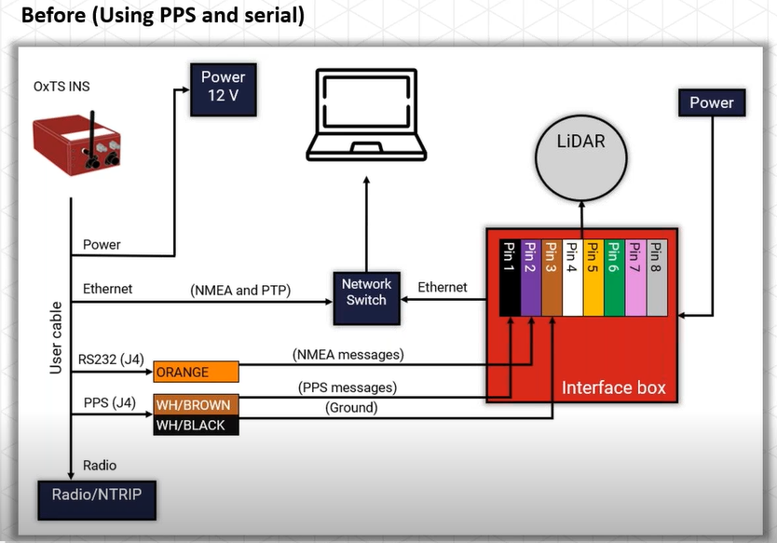

Slide 4
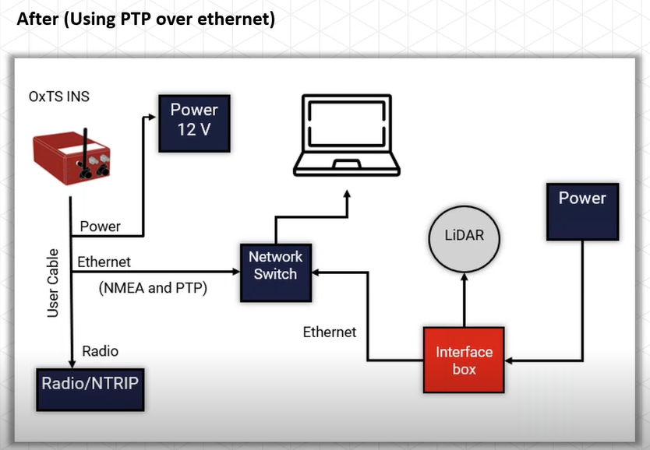

Slide 5
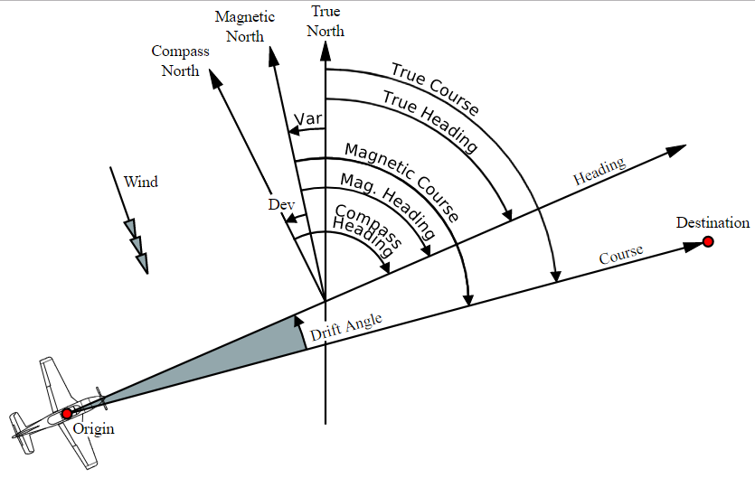
As per last r-mail:
That’s no problem if you don’t need the full NCOM data, you can also have NMEA data output over serial or ethernet. For example you can output GPRMC NMEA messages which contain
1 Time Stamp
2 validity - A-ok, V-invalid
3 current Latitude
4 North/South
5 current Longitude
6 East/West
7 Speed in knots
8 True course – Is this the true heading id degree with 0.1° accuracy ??
9 Date Stamp
10 Variation
11 East/West
12 checksum

Slide 6
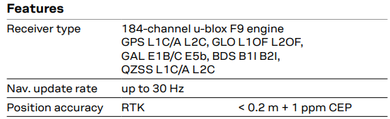
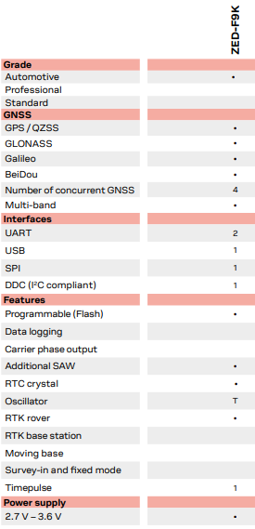
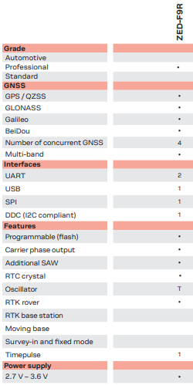
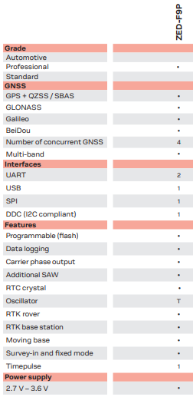
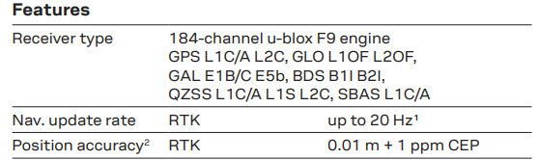
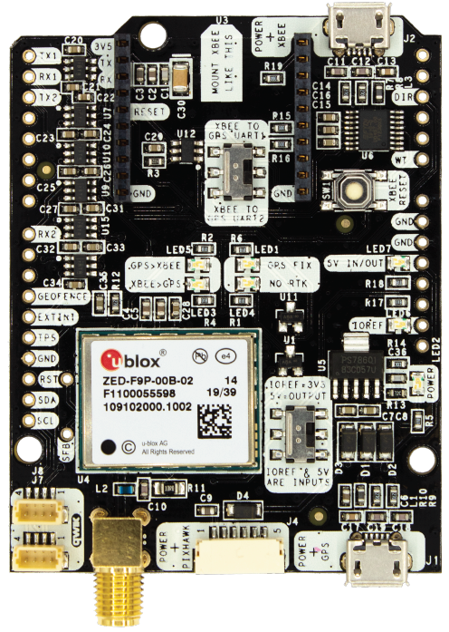
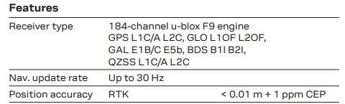
simpleRTK2B is u-blox ZED-F9P
ZED-F9K & ZED-F9R has an IMU, but F9P no, because it can be base as well !
Select for
rover
Select for base

Slide 7
BASE
ROVER
Calibrated Survey GNSS Multiband antenna
Calibrated Survey GNSS Multiband antenna
https://www.sparkfun.com/products/16344
(RTCM corr. data)
(RTCM corr. data)
RTK
TX⇨RX2
RTK+INS simpleRTK2B-F9R V3 shield in stand alone mode
Radio
XBee LR
simpleRTK2Blite
(ZED-F9P )
Laptop
RX⇦TX1
Rover pos.
https://www.ardusimple.com/product/simplertk2b-f9r-v3/
RX⇦TX2
(rover pos.)
(rover pos.)
TX1⇨RX0-3 (MEGA)
https://www.ardusimple.com/product/simplertk2blite/
Arduino MEGA
TX2⇨RX
TX⇨RX2
(rover pos.)
(RTCM corr. data)
RTK
(RTCM corr. data)
Radio
XBee LR
Rover pos.
Motor control
With encoders
https://www.sparkfun.com/products/16481
https://www.ardusimple.com/product/simplertk2b-heading-basic-starter-kit-ip67/

Slide 8
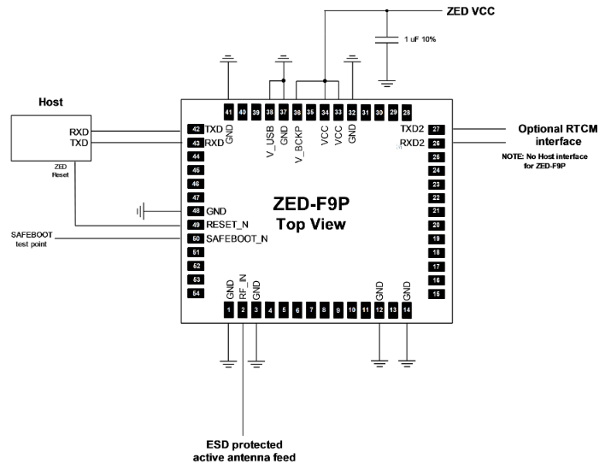

Slide 9
simpleRTK2Blite 199,00€
RTK+INS simpleRTK2B-F9R V3 486,00€
headers 5,00€
Pixhawk cable set 15,00€
XBee (LR) + Antenna 116,00€
XBee (LR) + Antenna 116,00€
Calibrated Survey GNSS Multiband antenna (IP67) 149,00€
Calibrated Survey GNSS Multiband antenna (IP67) 149,00€
Stand for survey GNSS Multiband antenna 18,00€
Stand for survey GNSS Multiband antenna 18,00€
Mouser.com
ZED-F9P-02B Rs15 000
ZED-F9R-02B Rs15 000
GPS Development Tools SparkFun GPS-RTK-SMA Breakout - ZED-F9P
16,796 = 190 EUR
SparkFun Accessories SparkFun GPS-RTK Dead Reckoning Breakout - ZED-F9R (Qwiic) 21,644 = 242 EUR
ZED-F9P
209,99 € tax excl.
https://www.gnss.store/gnss-gps-modules/99-ublox-zed-f9p-rtk-gnss-receiver-board-with-sma-base-or-rover.html
ZED-F9R
249,99 € tax excl
https://www.gnss.store/gnss-gps-modules/134-ublox-zed-f9r-elt0117.html
https://www.sparkfun.com/products/16344
189,99 € tax excl.
https://www.gnss.store/rf-gps-antennas/140-elt0123.html

Slide 10
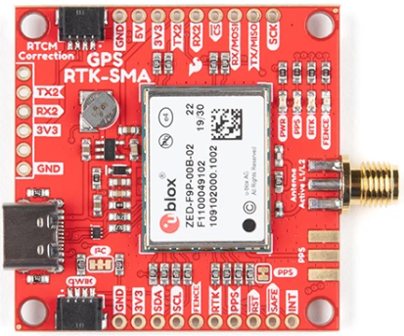
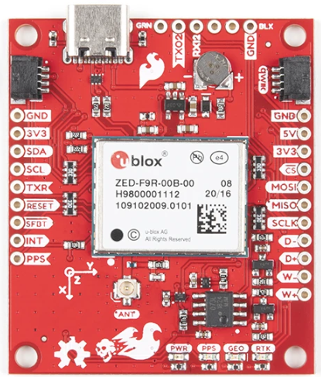
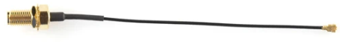
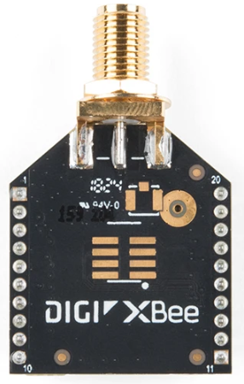
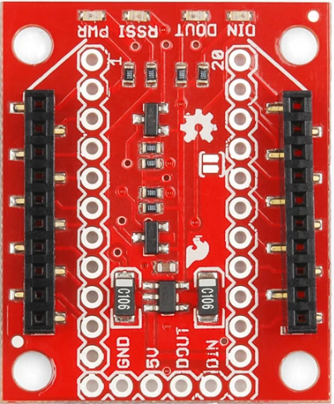
https://www.tanotis.com/products/sparkfun-gps-rtk-sma-breakout-zed-f9p-qwiic
Rs 24 000
https://www.tanotis.com/products/sparkfun-gps-rtk-dead-reckoning-breakout-zed-f9r-qwiic
Rs 30 000
https://www.tanotis.com/products/genuine-sparkfun-interface-cable-sma-to-u-fl
https://www.tanotis.com/products/sparkfun-xbee-3-module-rp-sma-antenna
https://www.tanotis.com/products/genuine-sparkfun-sparkfun-xbee-explorer-regulated
2,670
1,115

Slide 11
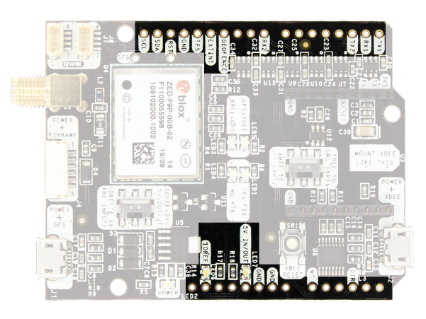

Slide 12
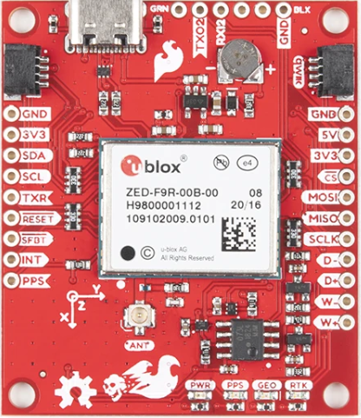
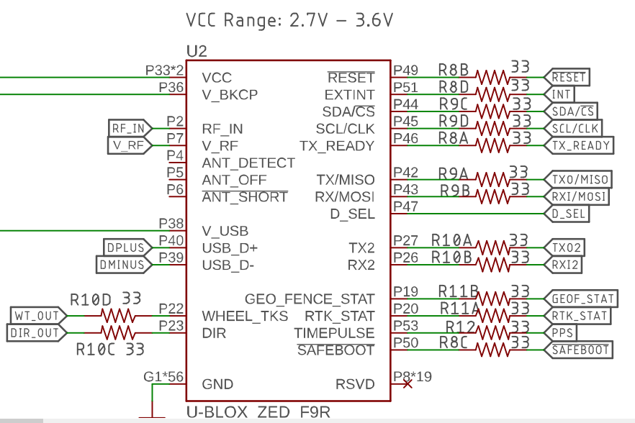
Rover msg to radio
RTK in
from radio
https://www.tanotis.com/products/sparkfun-gps-rtk-dead-reckoning-breakout-zed-f9r-qwiic?gclid=Cj0KCQjwsqmEBhDiARIsANV8H3aChXVXNU2BihZM26-xD0q3iITXEzSM_eGfl2cql53cwCX6hNuwVzwaAlHJEALw_wcB
GPS & IMU to rover
GPS & IMU to rover
Rover msg to radio
RTK in
from radio

Slide 13
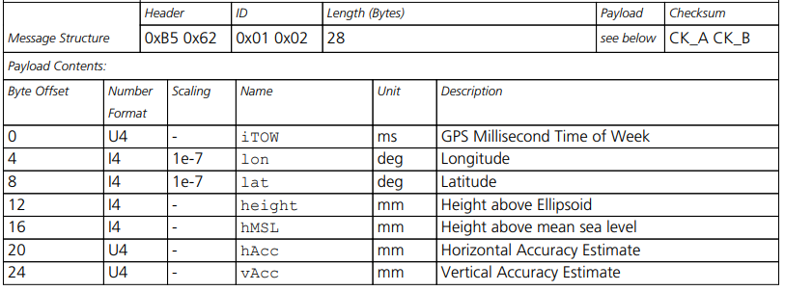
U-blox 6
Receiver description
Including protocol description
const unsigned char UBX_HEADER[] = { 0xB5, 0x62 };
struct NAV_POSLLH {
unsigned char cls;
unsigned char id;
unsigned short len;
unsigned long iTOW;
long lon;
long lat;
long height;
long hMSL;
unsigned long hAcc;
unsigned long vAcc;
};

Slide 14
const unsigned char UBX_HEADER[] = { 0xB5, 0x62 };
struct NAV_PVT {
unsigned char cls;
unsigned char id;
unsigned short len;
unsigned long iTOW; // GPS time of week of the navigation epoch (ms)
unsigned short year; // Year (UTC)
unsigned char month; // Month, range 1..12 (UTC)
unsigned char day; // Day of month, range 1..31 (UTC)
unsigned char hour; // Hour of day, range 0..23 (UTC)
unsigned char minute; // Minute of hour, range 0..59 (UTC)
unsigned char second; // Seconds of minute, range 0..60 (UTC)
char valid; // Validity Flags (see graphic below)
unsigned long tAcc; // Time accuracy estimate (UTC) (ns)
long nano; // Fraction of second, range -1e9 .. 1e9 (UTC) (ns)
unsigned char fixType; // GNSSfix Type, range 0..5
char flags; // Fix Status Flags
unsigned char reserved1; // reserved
unsigned char numSV; // Number of satellites
used in Nav Solution
long lon; // Longitude (deg)
long lat; // Latitude (deg)
long height; // Height above Ellipsoid (mm)
long hMSL; // Height above mean sea level (mm)
unsigned long hAcc; // Horizontal Accuracy Estimate (mm)
unsigned long vAcc; // Vertical Accuracy Estimate (mm)
long velN; // NED north velocity (mm/s)
long velE; // NED east velocity (mm/s)
long velD; // NED down velocity (mm/s)
long gSpeed; // Ground Speed (2-D) (mm/s) long heading; // Heading of motion 2-D (deg) unsigned long sAcc; // Speed Accuracy Estimate unsigned long headingAcc; // Heading Accuracy Estimate unsigned short pDOP; // Position dilution of precision short reserved2; // Reserved unsigned long reserved3; // Reserved};
void loop() { if ( processGPS() ) { Serial.print("#SV: "); Serial.print(pvt.numSV); Serial.print(" fixType: "); Serial.print(pvt.fixType); Serial.print(" Date:"); Serial.print(pvt.year); Serial.print("/"); Serial.print(pvt.month); Serial.print("/"); Serial.print(pvt.day); Serial.print(" "); Serial.print(pvt.hour); Serial.print(":"); Serial.print(pvt.minute); Serial.print(":"); Serial.print(pvt.second); Serial.print(" lat/lon: "); Serial.print(pvt.lat/10000000.0f); Serial.print(","); Serial.print(pvt.lon/10000000.0f); Serial.print(" gSpeed: "); Serial.print(pvt.gSpeed/1000.0f); Serial.print(" heading: "); Serial.print(pvt.heading/100000.0f); Serial.print(" hAcc: "); Serial.print(pvt.hAcc/1000.0f); Serial.println(); }}

Slide 15
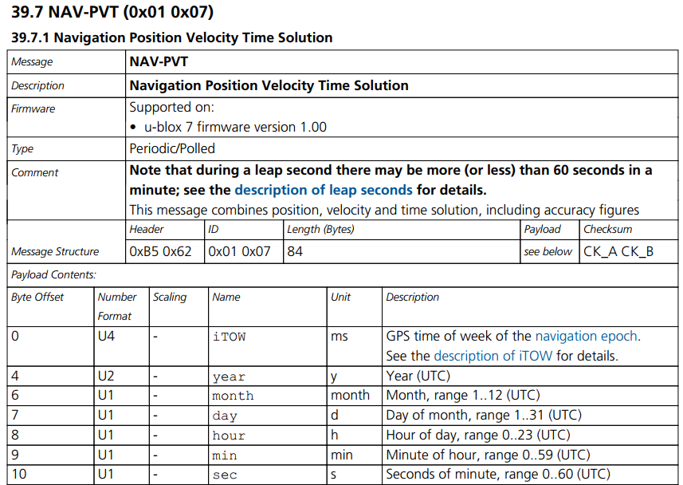
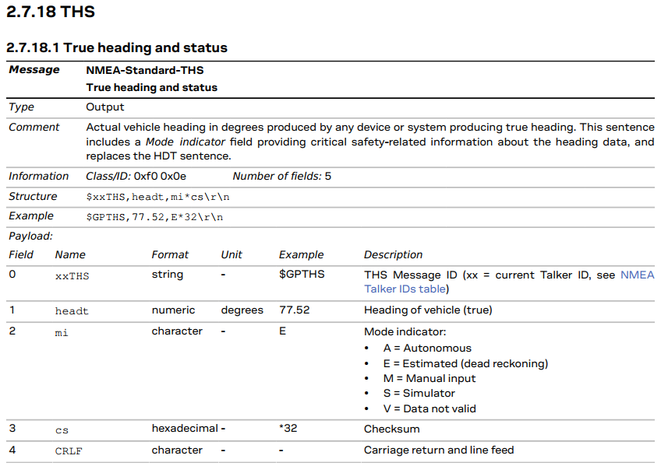
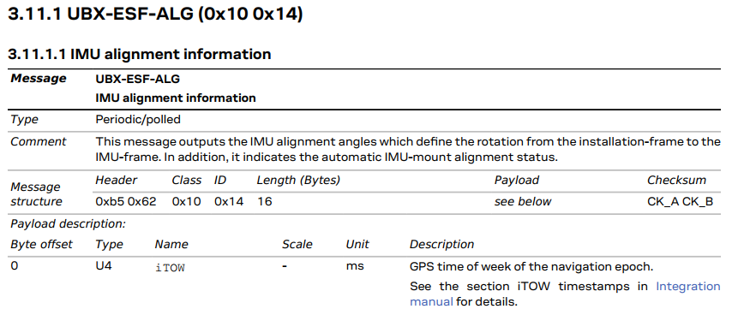
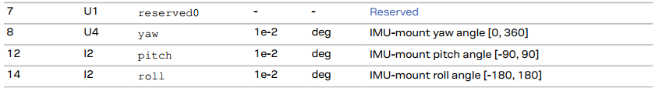

Slide 16
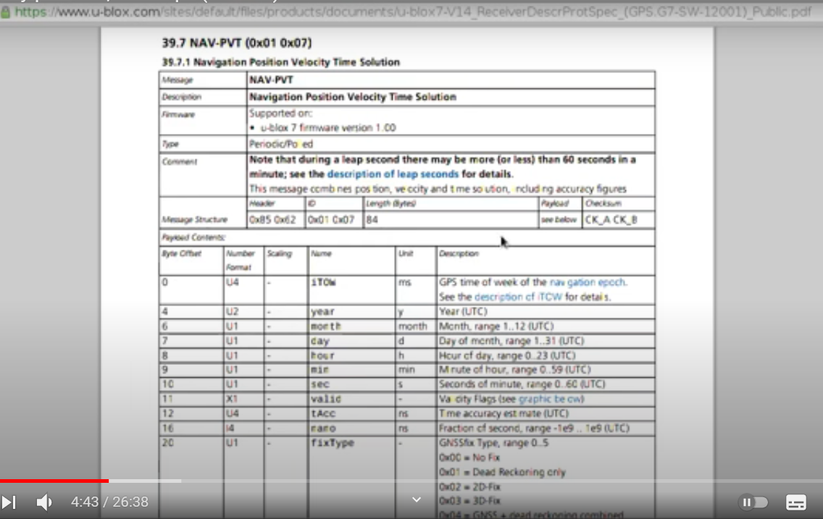

Slide 17
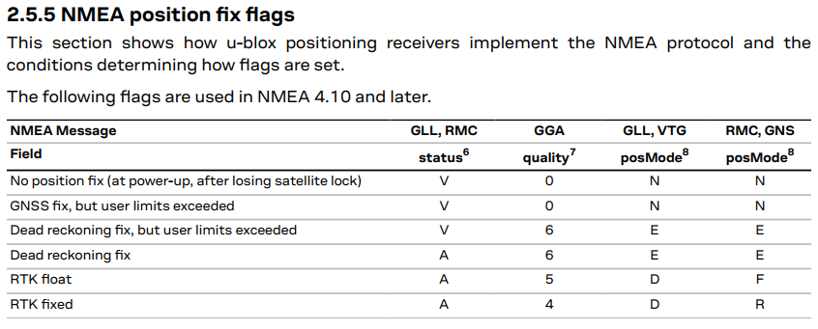

Slide 18
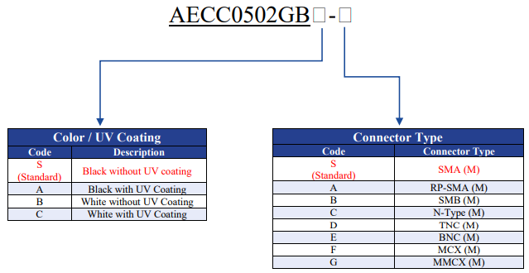
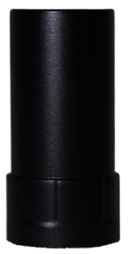
AECC0502GB – C
https://www.mouser.in/ProductDetail/ABRACON/AECC0502GBS-S?qs=eP2BKZSCXI6WHWNXCHgIFA%3D%3D
AEACMK0660746-SG4
Ultra- Low Profile
Active GNSS
GPS : L1/L2
GLONASS : G1/G2
BEIDOU/Compass : B1/B2/B3
GALIELO : E1/E5b
https://www.mouser.in/ProductDetail/ABRACON/AEACMK0660746-SG4?qs=Cb2nCFKsA8qSI2ROBfTxbg%3D%3D
AEAGMK148060-S1575
GPS: L1/L2/L5/L6
BEIDOU: B1/B2/B3
GLONASS: L1/L2
Galileo: L1/E5b/E5a
QZSS: L1/L2/L5/L6
https://www.mouser.in/ProductDetail/ABRACON/AEAGMK148060-S1575?qs=fAHHVMwC%252Bbg%2FdxTyG9xYxQ%3D%3D

Slide 19
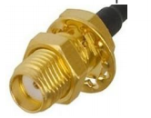
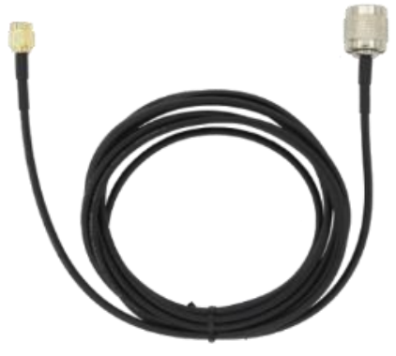
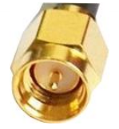
https://www.mouser.in/ProductDetail/ArduSimple/AS-ANT2B-SUR-L1L2-25SMA-00?qs=vHuUswq2%252BswBsit1qMDm7Q%3D%3D
GPS L1/L2
GLONASS L1/L2
COMPASS B1/B2/B3
Galileo E1/E5b/E6
SMA (F, jack) Bulkhead Straight
TNC Female (2.5m cable to SMA male included)
Heatshrink
Heatshrink
.SMA (M, plug) Bulkhead Straight
. RG58 Cable

